Slide 1

10.03.23
LO: Recapping fractions, decimals and percentages

Slide 2
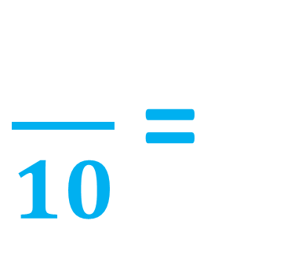
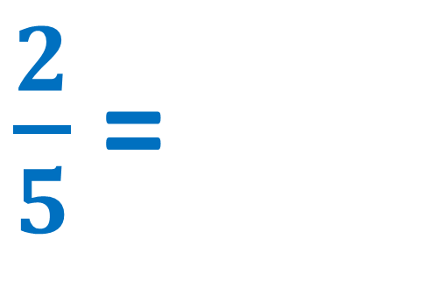
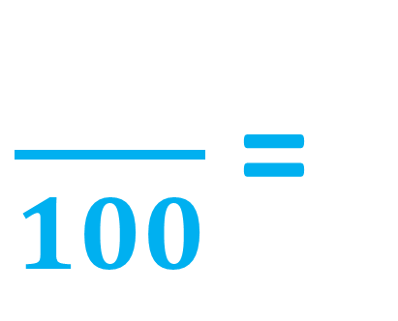
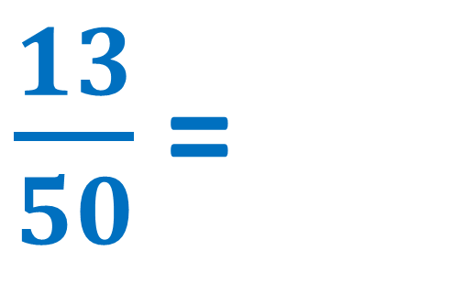
Equivalent FDP
How can we convert fractions to decimals?
Complete the missing numbers.
4
x2
$\frac{}{10}$ =
$\frac{2}{5}$ =
4
0.__
x2
x2
26
$\frac{}{100}$ =
$\frac{13}{50}$ =
26
0.__
x2
I can recall simple FDP equivalents.
I can convert between FDP.
I can solve problems by converting between FDP.

Slide 3
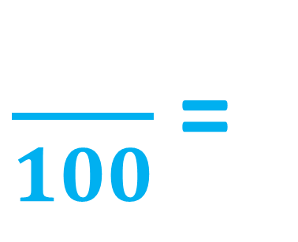
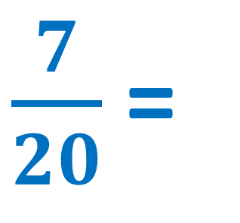

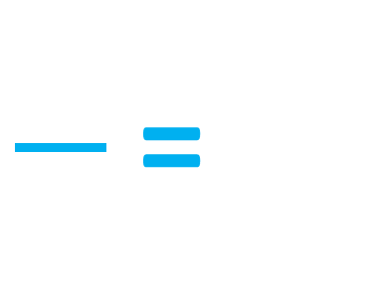
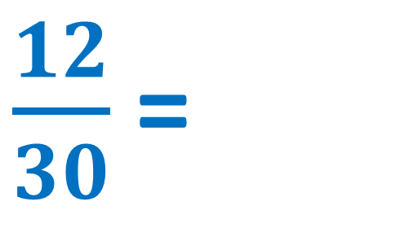
Equivalent FDP
How can we convert fractions to percentages?
Complete the missing numbers.
x5
35
$\frac{7}{20}$ =
$\frac{}{100}$ =
35
___%
x5
÷3
4
x10
40
=
$\frac{}{100}$ =
$\frac{12}{30}$ =
40
___%
10
÷3
x10
I can recall simple FDP equivalents.
I can convert between FDP.
I can solve problems by converting between FDP.

Slide 4
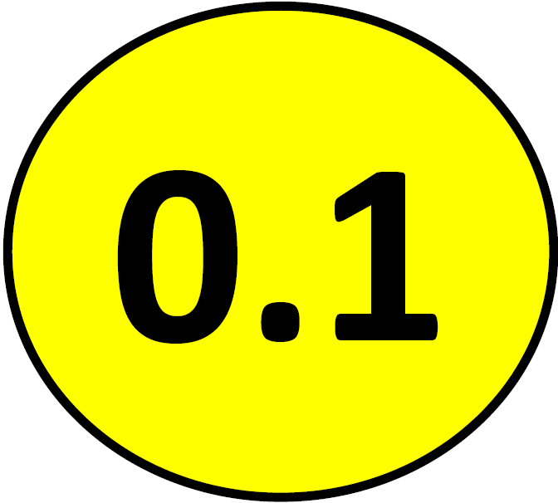
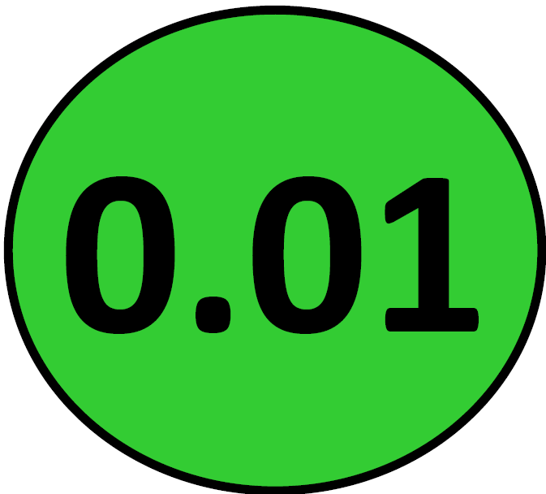
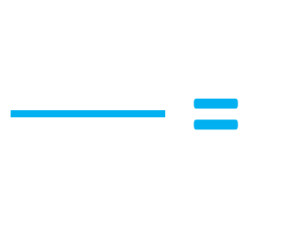
Equivalent FDP
How can we convert decimals to percentages?
Complete the missing numbers.
O | Tth | Hth
32
=
0.32 =
32
___%
100
Make this decimal into a fraction over 100.
I can recall simple FDP equivalents.
I can convert between FDP.
I can solve problems by converting between FDP.

Slide 5
Equivalent FDP
How can we convert decimals to percentages?
Complete the missing numbers.
O | Tth | Hth
6
=
0.6 =
60
___%
10
Make this decimal into a fraction over 10.
I can recall simple FDP equivalents.
I can convert between FDP.
I can solve problems by converting between FDP.

Slide 6
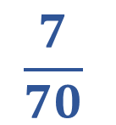
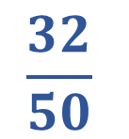
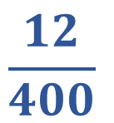
Equivalent FDP
Match the fraction to the equivalent
decimal and percentage.
Remember to convert the fractions into a fraction either over 10 or over 100 first!
$$\frac{32}{50}$$
0.1
64%
$$\frac{7}{70}$$
0.03
10%
$$\frac{12}{400}$$
0.64
3%
I can recall simple FDP equivalents.
I can convert between FDP.
I can solve problems by converting between FDP.

Slide 7
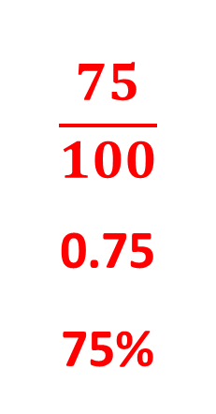
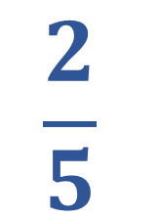
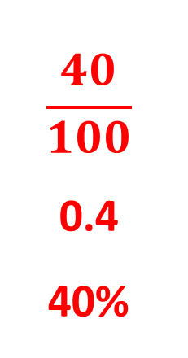
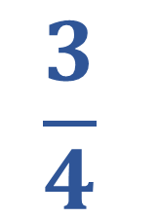
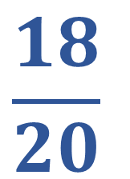
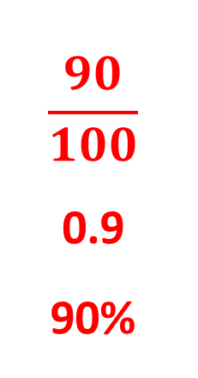
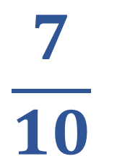
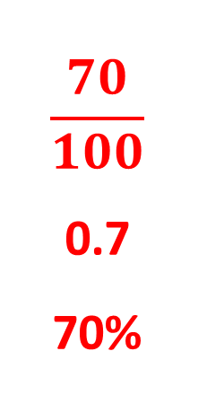
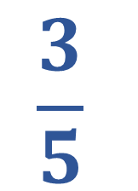
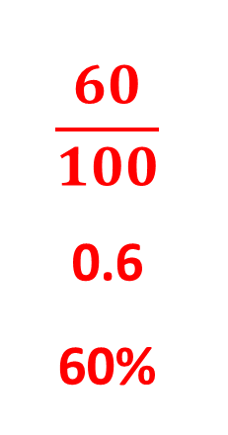
Equivalent FDP
Convert these fractions to hundredths and then decimals and percentages.
$$\frac{2}{5}$$
$$\frac{3}{4}$$
$$\frac{3}{5}$$
$$\frac{7}{10}$$
$$\frac{18}{20}$$
$$\frac{40}{100}$$
0.4
40%
$$\frac{75}{100}$$
0.75
75%
$$\frac{60}{100}$$
0.6
60%
$$\frac{70}{100}$$
0.7
70%
$$\frac{90}{100}$$
0.9
90%
I can recall simple FDP equivalents.
I can convert between FDP.
I can solve problems by converting between FDP.

Slide 8
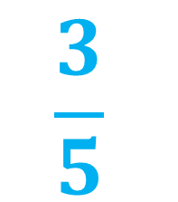
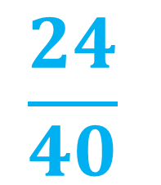
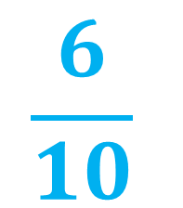
Equivalent FDP
What Fraction, Decimal and Percentage is represented below? (Think carefully about the diagram).
Explain how you found your answers.
$$\frac{6}{10}$$
$$\frac{24}{40}$$
$$\frac{3}{5}$$
60%
0.6
I can recall simple FDP equivalents.
I can convert between FDP.
I can solve problems by converting between FDP.

Slide 9


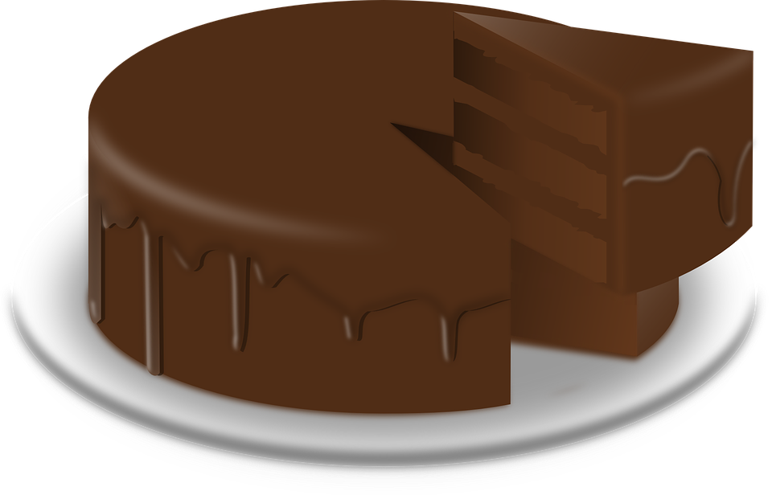
Equivalent FDP
Who has the largest percentage
of their cake leftover?
I have eaten thirty-six sixtieths of my cake.
I have eaten 0.65 of my cake.
35% leftover
40% leftover
I can recall simple FDP equivalents.
I can convert between FDP.
I can solve problems by converting between FDP.

Slide 10






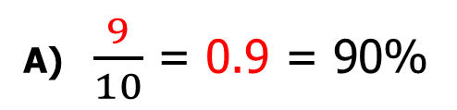
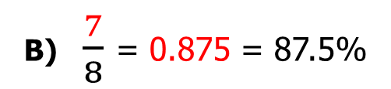
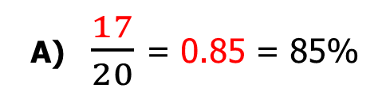
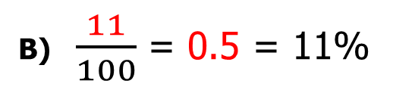
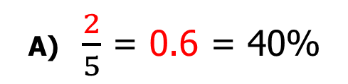
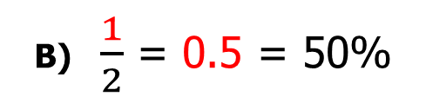
Activity 1
Copy and complete the table.
Activity 1
Copy and complete the table.
Activity 1
Copy and complete the table.
Fraction | Decimal | Percentage
 | 0.75
1/2
 |  | 70%
2/5
Fraction | Decimal | Percentage
 |  | 75%
 | 0.5
 |  | 90%
3/5
Fraction | Decimal | Percentage
 |  | 27%
 | 0.6
 |  | 9%
1/8
Activity 2 Fill in the missing numbers.
Activity 2 Fill in the missing numbers.
Activity 2 Fill in the missing numbers.
A) $\frac{9}{10}$ = 0.9 = 90%
A) $\frac{2}{5}$ = 0.6 = 40%
A) $\frac{17}{20}$ = 0.85 = 85%
B) $\frac{1}{2}$ = 0.5 = 50%
B) $\frac{11}{100}$ = 0.5 = 11%
B) $\frac{7}{8}$ = 0.875 = 87.5%
Activity 3 Do you agree? Prove it.
Activity 3 Do you agree? Prove it.
Activity 3 Do you agree? Prove it.
If I give 25% of my sweets to my friends,
I will have 0.5 left.
If I eat 60% of my pizza, there will be three fifths left.
I read six fortieths of my book so there is 85% left.
Activity 4
Ben scored 60% in a test.
Sue scored 28/35 in a test.
Matt scored 0.85 in a test.
Who read the most?
Activity 4
Tom ate 50% of his cake.
Amy ate 7/10 of her cake.
Jack ate 0.6 of his cake.
Who ate the most pizza?
Activity 4
Jim read 75% of his book.
Jane read 3/5 of her book.
Jack read 0.8 of his book.
Who read the most?
Investigation:
What FDP of your class are boys or girls?

Slide 11
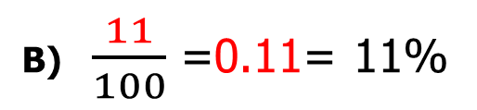
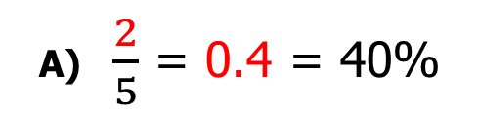
Activity 1
Activity 1
Activity 1
Fraction | Decimal | Percentage
3/4 | 0.75 | 75%
1/2 | 0.5 | 50%
7/10 | 0.7 | 70%
2/5 | 0.4 | 40%
Fraction | Decimal | Percentage
3/4 | 0.75 | 75%
1/2 | 0.5 | 50%
9/10 | 0.9 | 90%
3/5 | 0.6 | 60%
Fraction | Decimal | Percentage
27/100 | 0.27 | 27%
3/5 | 0.6 | 60%
9/100 | 0.09 | 9%
1/8 | 0.125 | 12.5%
Activity 2
Activity 2
Activity 2
A) $\frac{9}{10}$ = 0.9 = 90%
A) $\frac{2}{5}$ = 0.4 = 40%
A) $\frac{17}{20}$ = 0.85 = 85%
B) $\frac{1}{2}$ = 0.5 = 50%
B) $\frac{11}{100}$ =0.11= 11%
B) $\frac{7}{8}$ = 0.875 = 87.5%
Activity 3
False, there would be 75%, 0.75 or ¾ left.
Activity 3
False, there would be 40%, 0.4 or 2/5 left.
Activity 3
True, there would be 34/40, 0.85 or 85% left.
Activity 4
Tom=50%, 5/10, 0.5
Amy=70%, 7/10, 0.7
Jack=60%, 6/10, 0.6
Activity 4
Jim=75%, 75/100, 0.75
Jane=60%, 60/100, 0.6
Jack=80%, 80/100, 0.8
Activity 4
Ben=60%, 60/100, 0.6
Sue=80%, 8/100, 0.8
Matt=85%, 85/100, 0.85

