Slide 1
Can I add together?

Slide 2
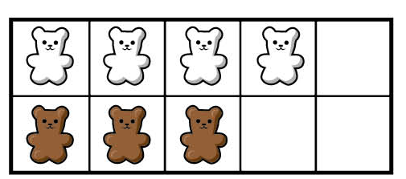
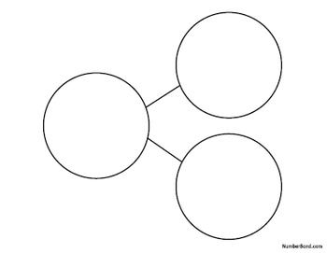
Complete the sentences and part whole model.
There are ____ white bears.
There are ____ brown bears.
There are ____ bears altogether.
_____ + _____ = _____

Slide 3
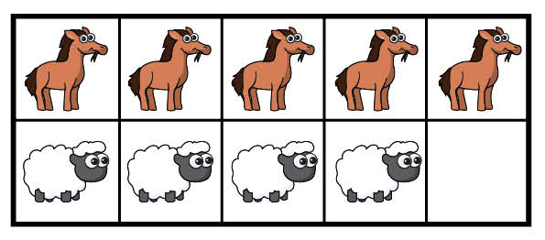
There are ____ horses.
There are ____ sheep.
There are ____ in total.
_____ + _____ = _____
_____ + _____ = _____

Slide 4
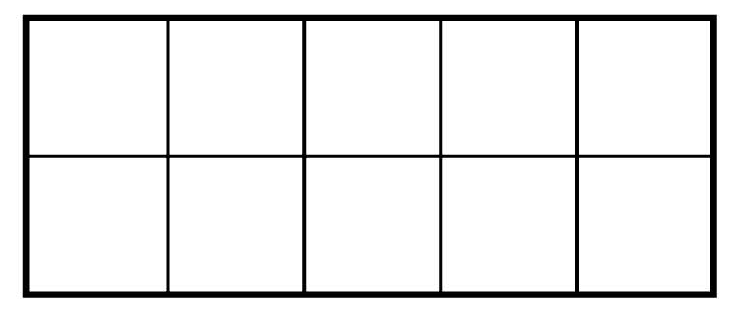
Draw counters to show the objects.
There are 5 yellow sweets and 2 green sweets.
How many sweets are there altogether?
______ + ______ = ______
______ + ______ = ______

Slide 5
Draw counters to show the objects.
There is 1 blue car and 8 red cars.
How many cars are there total?
______ + ______ = ______
______ = ______ + ______
______ + ______ = ______

Slide 6
Draw counters to show the objects.
Ron has 2 dogs and 3 cats.
How many animals does he have altogether?
______ + ______ = ______
______ = ______ + ______
______ + ______ = ______
______ = ______ + ______

Slide 7
True or False?
The counters and part part whole model show the same question. Explain how you know.

Slide 9
_____________ red and _____________ yellow.
_____________ red and _____________ yellow.
_____________ red and _____________ yellow.

