Slide 1
2. Go to Purple Mash and practise adding commas to fronted adverbial sentences.
3. Complete the sentences into your book from the fronted adverbial worksheets.
Monday: Fronted adverbials
1.Watch the video and complete the tasks on BBC Bitesize
https://www.bbc.co.uk/bitesize/topics/zwwp8mn/articles/zp937p3

Slide 2
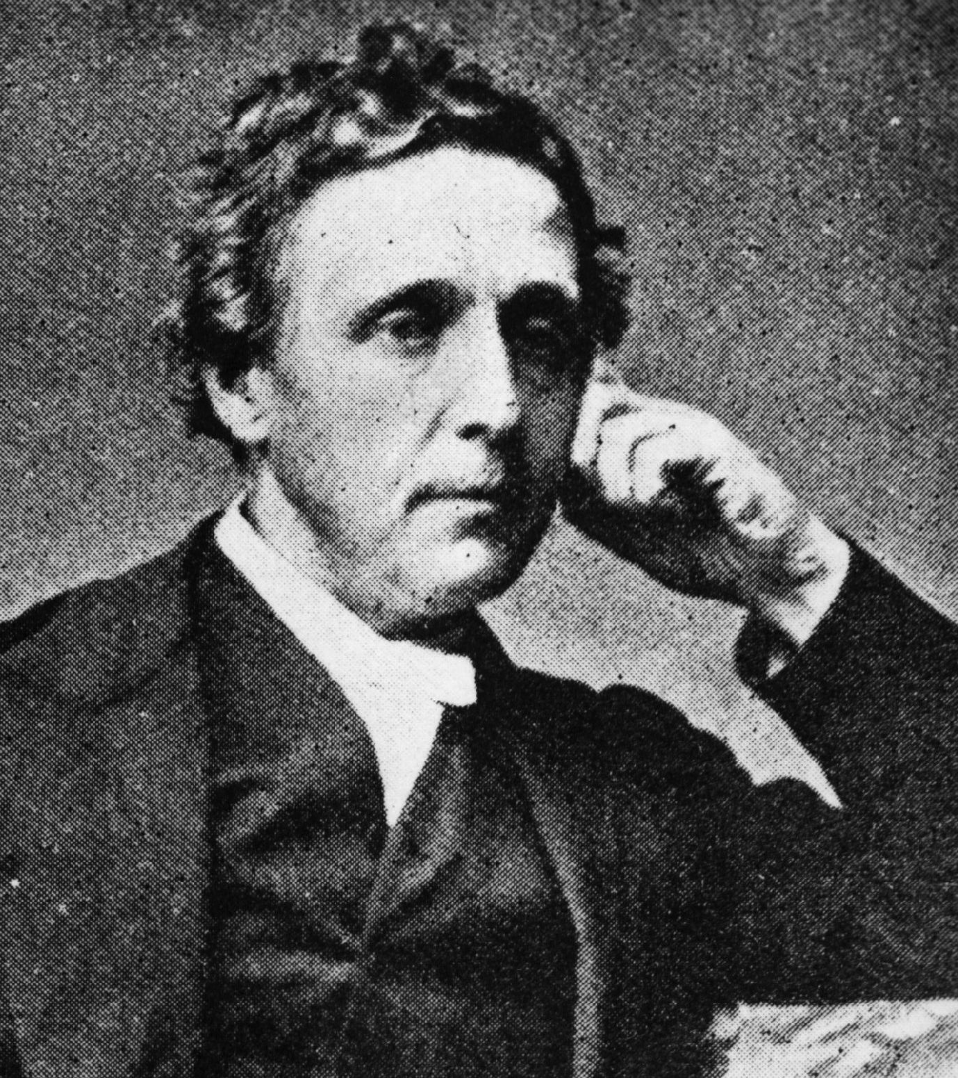

Tuesday:
Research Lewis Carroll and list 10 facts about his life
Use bullet points and notes- not full sentences

Slide 3
Wednesday:
Lewis Carroll Biography Poster
Use your Lewis Carroll notes to create a biography poster
Organise your information into paragraphs/ text boxes
Add sub headings
Add illustrations/ diagrams
*** Challenge***
Can you include 2 fronted adverbials in your biography? Use the examples on the next slide to help you.

Slide 4
Time | Frequency | Place | Manner | Possibility
Afterwards, | Often, | Above the clouds, | Sadly, | Almost unbelievably,
Already, | Again, | Below the sea, | Slowly, | Much admired,
Always, | Daily, | Here, | Happily, | Nearly asleep,
Immediately, | Weekly, | Outside, | Awkwardly, | Quite understandably,
Last month, | Fortnightly, | Over there, | Bravely, | Really happily,
Now, | Yearly, | There, | Like a ... , | Perhaps,
Soon, | Sometimes, | Under the ground, | As quick as a flash, | Maybe,
Yesterday, | Rarely, | Upstairs, | As fast as he could, | Just arrived,
Today, | Every second, | In the distance, | Without a sound, | Certainly amused,
Tomorrow, | Twice a year, | Between the sea and the sky, | Without warning, | Obviously angry,
Next year, | Once a minute, | Everywhere she looked, | Unexpectedly, | Definitely confused,
In January, | Once, | Around the tent, | Unfortunately, | Completely exhausted,
On Tuesday, | Once or twice, | Back at the house, | Suddenly, | Barely alive,
In the morning, | Three times, | Nearby, | Mysteriously, | Out of breath,
After a while, | Constantly, | Down by the cliffs, | Frantically, | Decidedly unimpressed,
As soon as she could, | Regularly, | Behind the shed, | Anxiously, | Perfectly confident,
Before long, | Frequently, | In the wooden box, | Courageously, | Positively trembling with
All of a sudden, | Infrequently, | Over my bed, | Silently, | excitement,
In the blink of an eye, | Occasionally, | Somewhere near here, | Curiously, | Purely practically,
Just then, | Rarely, | Far away, | Nervously, | Somewhat flustered,
Eventually, | Never in my life, | Wherever they went, | Rapidly, | Utterly joyous,
Later, | Never before, | North of here, | Carefully, | Totally overwhelmed,

Slide 5
Thursday
1. Go to Purple Mash and revise speech punctuation
2. Copy the sentences from the activity sheet into your book, including the correct punctuation.

Slide 6
Friday
Click on the link and watch the cartoon clip WITHOUT SOUND https://www.youtube.com/watch?v=msvOUUgv6m8
You are going to write some dialogue (a conversation) between Alice, March Hare, Dormouse and the Hatter. You can decide what they might be saying to each other.
Just choose which part of the clip you want to use
Write at least 5 speech sentences/exchanges
REMEMBER- new speaker- new line

