Slide 1
Wednesday 20th January 2021
Can I illustrate examples of how to be a fisher for Jesus?

Slide 2
In this story, on the Sea of Galilee, Jesus calls upon the First Disciples as he performs a miraculous catch of fish after the fishermen had been unsuccessful. The fishers were astonished by the miracle as a demonstration of the presence of God, which was the first step in understanding who Jesus is. Jesus calls the common fishermen to leave everything and become his disciples as “Fishers of men”.

Slide 3
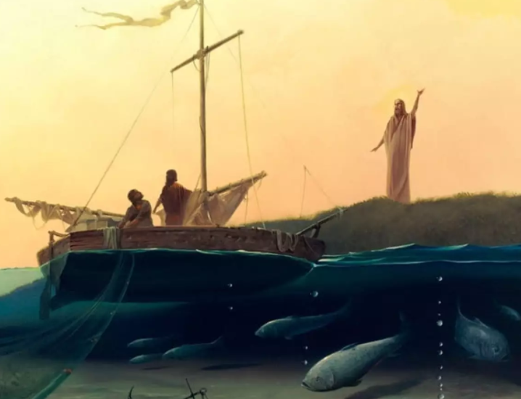

Slide 4
Matthew 4:18-22
18 As Jesus was walking beside the Sea of Galilee, he saw two brothers, Simon called Peter and his brother Andrew. They were casting a net into the lake, for they were fishermen.
19 “Come, follow me,” Jesus said, “and I will send you out to fish for people.”
20At once they left their nets and followed him.

Slide 5
Cont…
21 Going on from there, he saw two other brothers, James son of Zebedee and his brother John. They were in a boat with their father Zebedee, preparing their nets. Jesus called them.
22 and immediately they left the boat and their father and followed him.

Slide 6
Activity One
Answer the following questions in your RE/green book.
1.What did James and John leave behind?
2.What did they gain with their new jobs by being Jesus’ disciples?
3.What do you think Jesus means by being a fisher of people?

Slide 7
Discussion
3.What do you think Jesus means by being a fisher of people?
- Jesus wanted his disciples to grow the Kingdom of God.
- The story mentions the word follow/come, which is an instruction to follow Jesus.

Slide 8






Activity Two – Fish Collage
In each section or scale, draw a picture of the types of roles or duties a person might carry out. (who is a ‘fisher of men/people’.

Slide 9
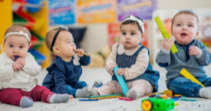
What other examples could you include in your fish collage?
toddler groups
shelters
giving to charity

Slide 10
A thought to finish on
How can you be a fisher for Jesus?

