Slide 1



Slide 2
Aim
I can present a picture of family members using possessive adjectives.
Success Criteria
I can identify family members.
I can say ‘My…’
I can use voici to explain who’s who in a picture.

Slide 3



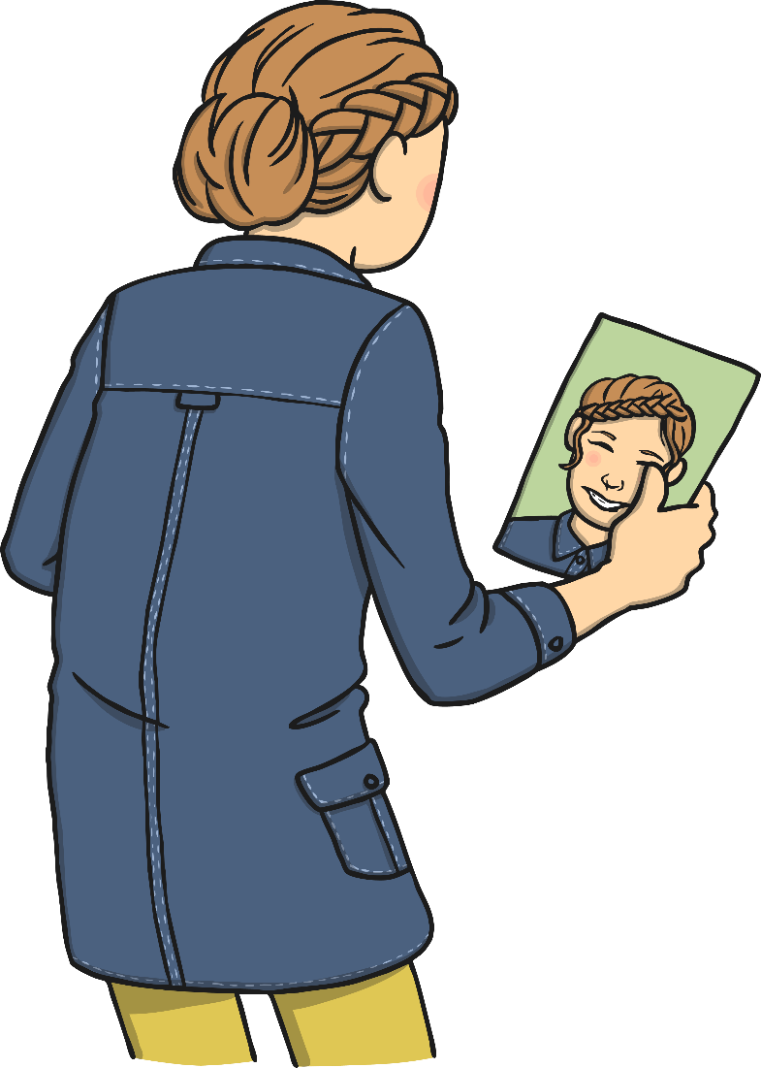

Qui Est-Ce?
(Who’s This?)
Click play buttons throughout to hear phrases and words.
C’est moi!

Slide 4
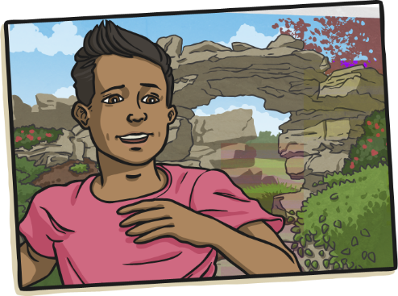
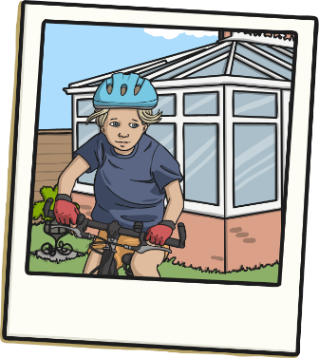
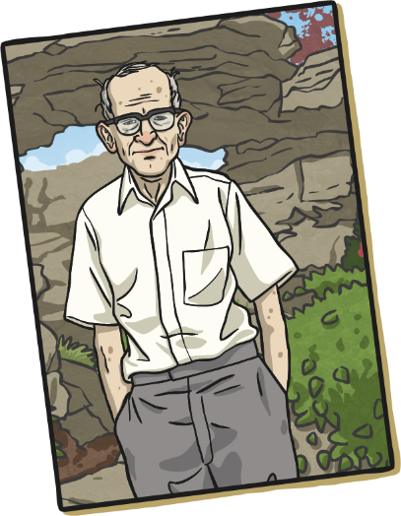
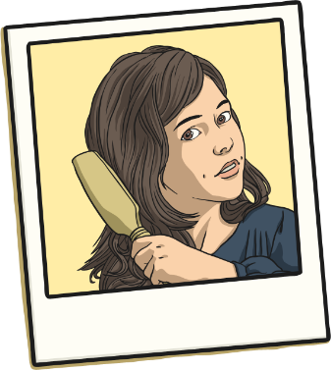
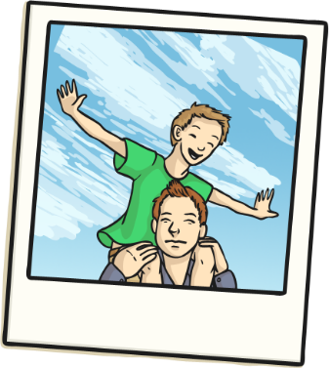
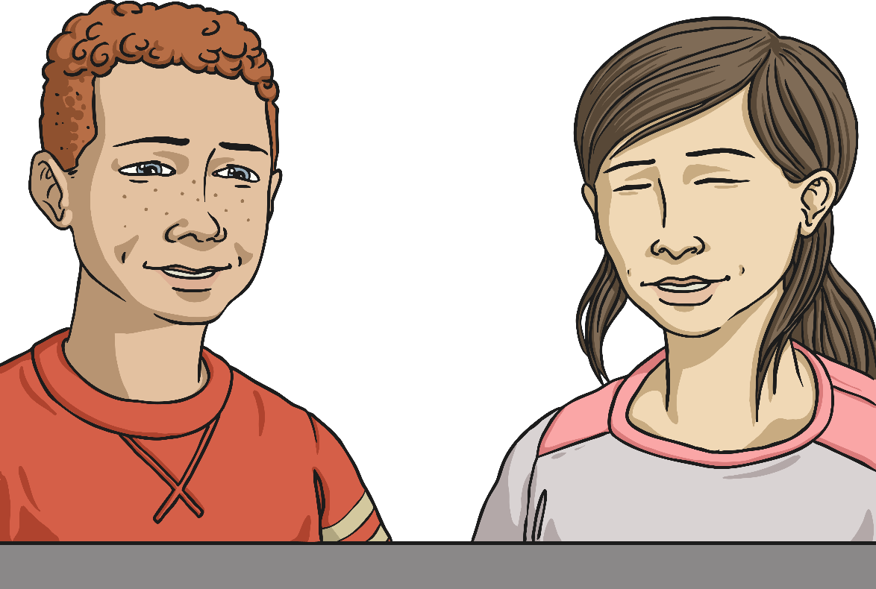
Who’s In Your Family?
Think about who is in your family.
Do you have an aunt?
How about a brother or sister?

Slide 5

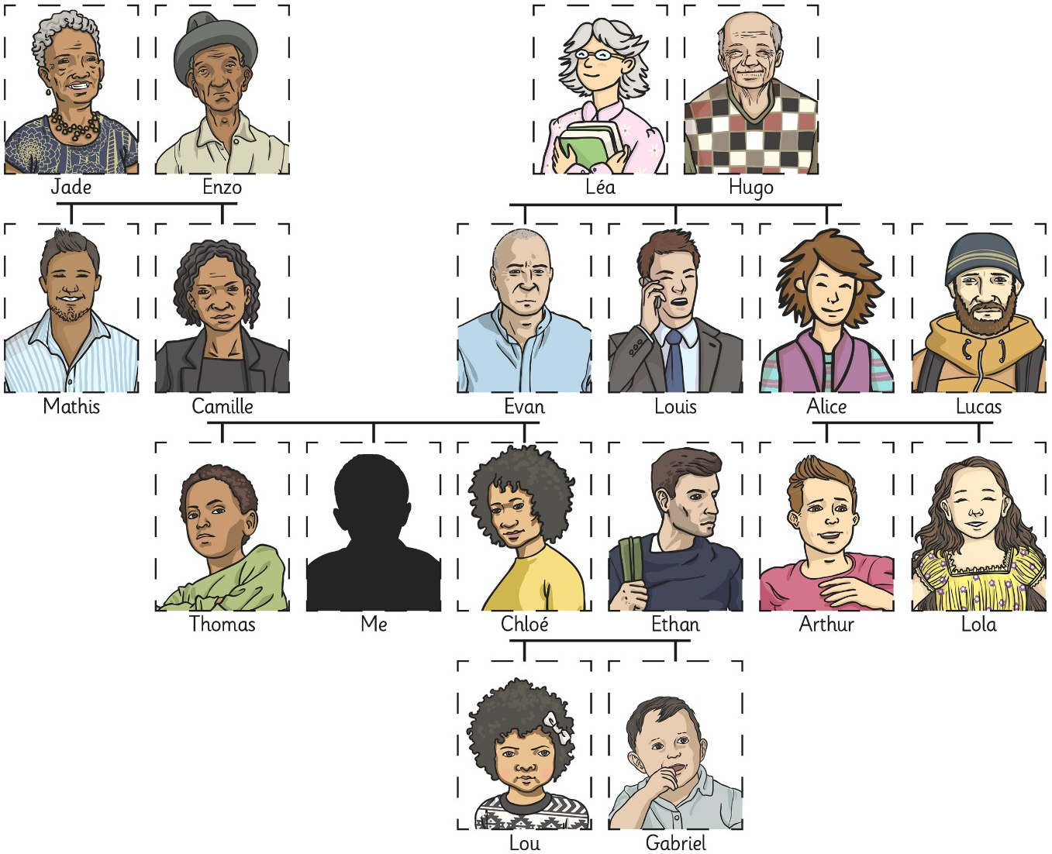

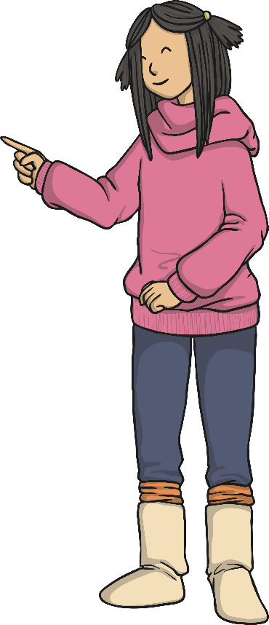
Qui Est-Ce?
Voici Jade.

Slide 6
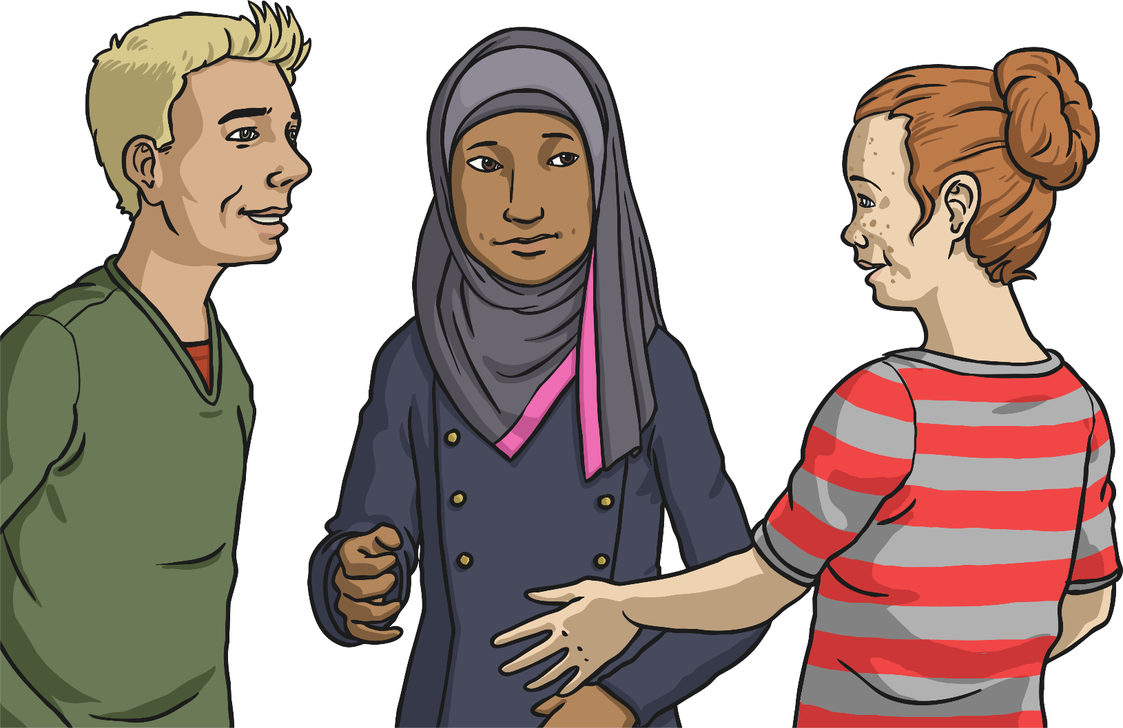
Qui Est-Ce?
Voici Sam.

Slide 7
Qui Est-Ce?
Voici
...ma famille.

Slide 8
Qui Est-Ce?
Voici
...mon frère.

Slide 9
Qui Est-Ce?
Voici
...ma soeur.

Slide 10
Qui Est-Ce?
Voici
...ma mère.

Slide 11
Qui Est-Ce?
Voici
...mon père.

Slide 12
Qui Est-Ce?
Voici
...mes parents.

Slide 13

Qui Est-Ce?
Voici
...mon grand-père.

Slide 14
Qui Est-Ce?
Voici
...ma grand-mère.

Slide 15
Qui Est-Ce?
Voici
...mes grands-parents.

Slide 16
La Grammaire
(Grammar Point)
mon...
un...
ma...
une...
mes... / mes…
des... / des…
What do you think?

Slide 17
Qui Est-Ce?
Voici
...ma tante.

Slide 18
Qui Est-Ce?
Voici
...mon oncle.

Slide 19
Qui Est-Ce?
Voici
...ma cousine.

Slide 20
Qui Est-Ce?
Voici
...mon cousin.

Slide 21
Qui Est-Ce?
Voici
...mes cousins.

Slide 22
Qui Est-Ce?
Voici
...mon neveu.

Slide 23
Qui Est-Ce?
Voici
...ma nièce.

Slide 24
Qui Est-Ce?
Voici
...ma famille!

Slide 25

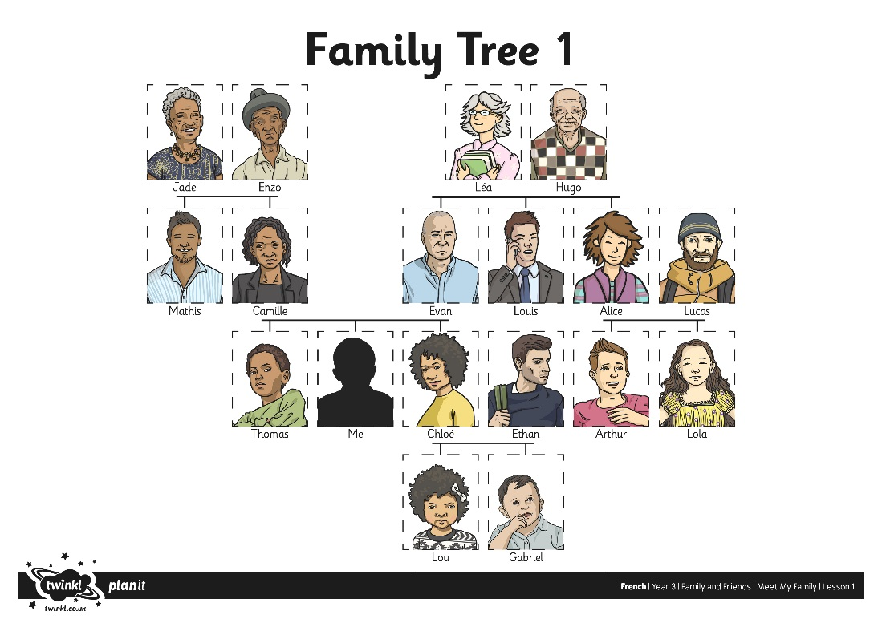
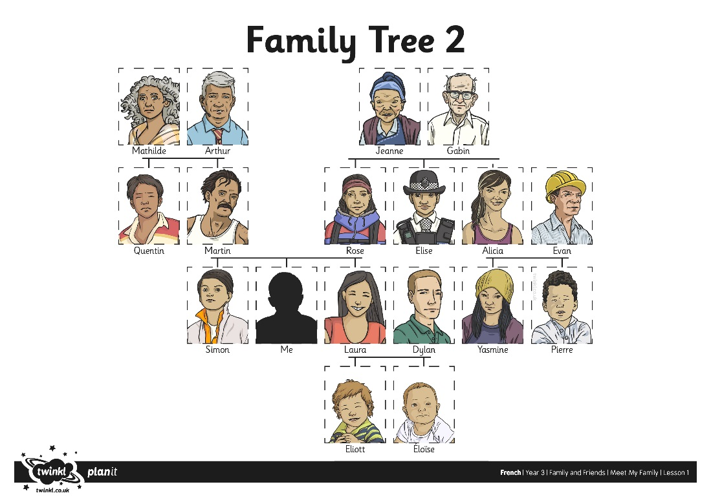
Family Trees

Slide 26

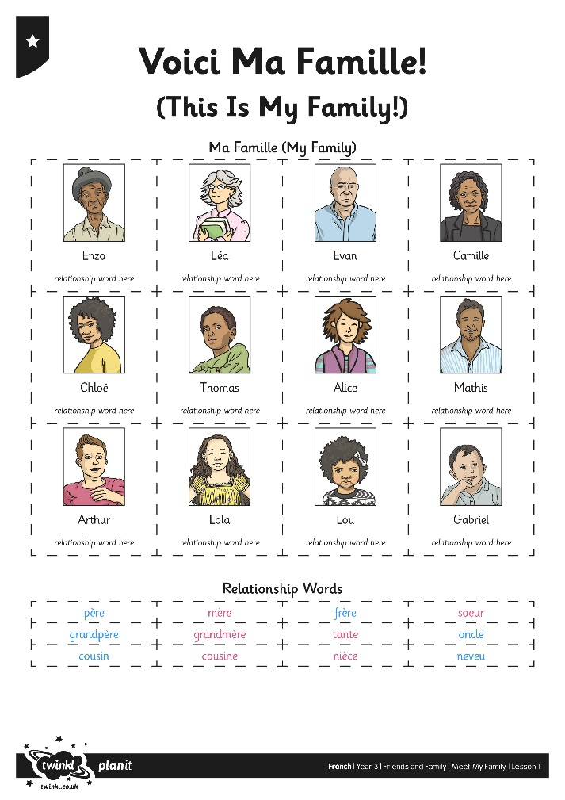
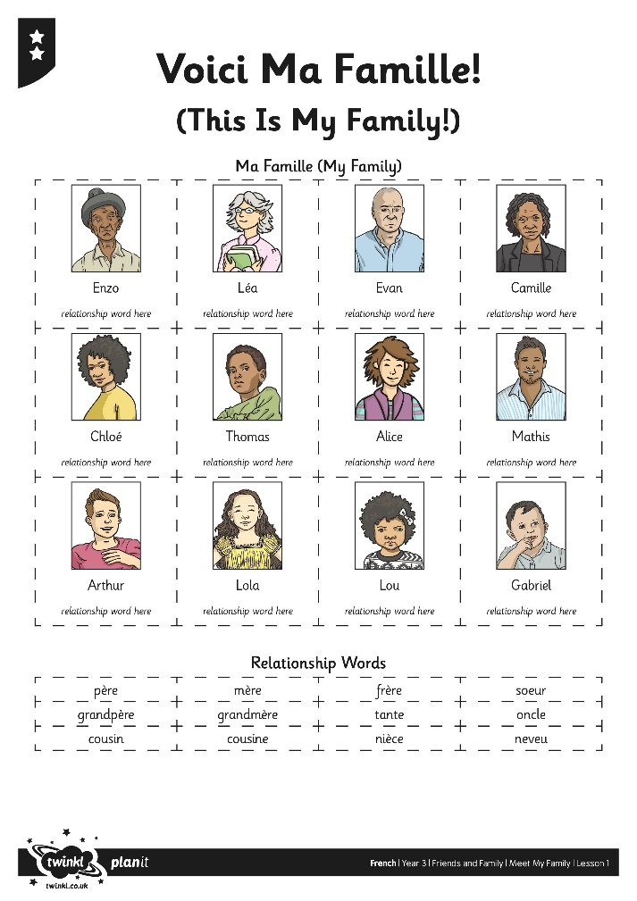
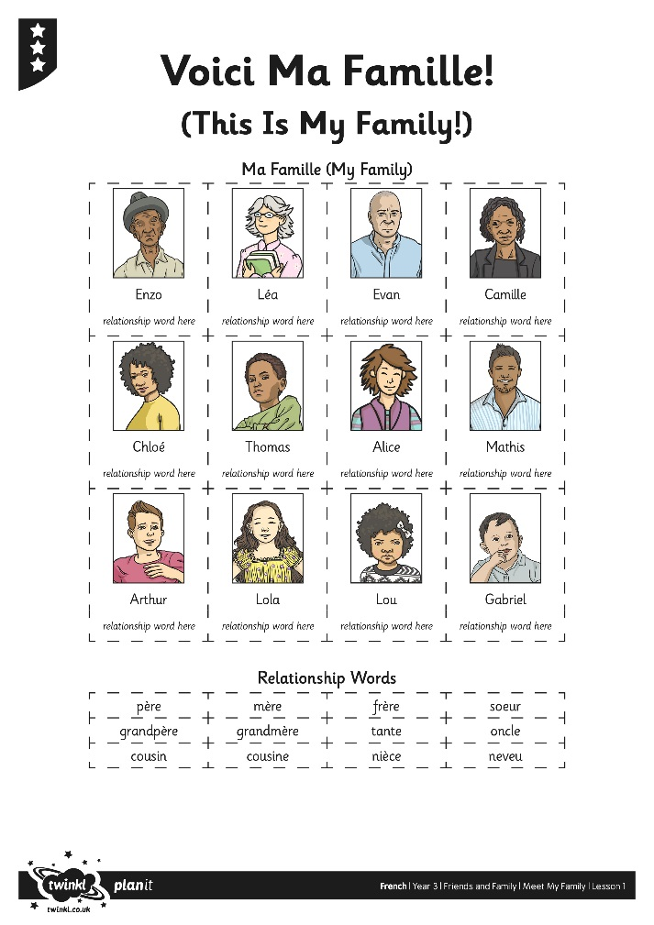
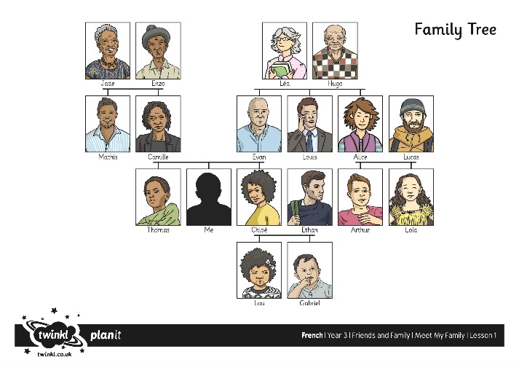
Who’s Who?

