Slide 1


St. Luke’s CofE Primary School
Induction Evening
2026-2027

Slide 2
Practitioners
Class teacher – Minakshi Gadhok (Maternity cover)
Mrs Sukhpreet Charna after November

Slide 3
What is the Early Years Foundation Stage?
Stage of education from birth to the end of the academic year they are 5.
Children learn best through play and active learning.

Slide 4
  “Adults who help children to play are adults who help children to learn.”

Slide 5
Supporting Early Learning
Hurst V. & Joseph J. (1988 p88)
We know from experience that anxiety, insecurity and stress can seriously undermine what we want to do. It is extremely difficult, for instance to work or study when such emotions are flooding through us.
  We regain our zest and determination and drive when we have a sense of being at ease with ourselves, confident and secure in the feeling that we can achieve what we want.

Slide 6
Four Guiding Principles
Unique child
Positive relationships
  Every child is consistently learning and can be resilient, capable and confident.
  This is the way children learn to be strong and independent.
Enabling environments
Different rates of learning
  Experiences which respond to needs alongside strong partnerships between practitioners and parents/carers.
  Children develop and learn in different ways and times.

Slide 7
The seven areas in EYFS
  Three prime areas...
  Communication and Language
Listening, Attention and Understanding
Speaking
  Personal, Social and Emotional Development
Self-regulation
Managing Self
Building Relationships
  Physical Development
Gross motor skills
Fine motor skills
These areas are fundamental and support development in all other areas.
These areas underpin the four specific areas.

Slide 8

  Four specific areas...
  Literacy
Comprehension
Word reading
Writing
  Mathematics
Numbers
Numerical Patterns
  Understanding The World
Past and Present
People, Culture and Communities
The Natural World
  Expressive Arts and Design
Creating with Materials
Being Imaginative and Expressive
Include essential skills and knowledge for children to participate successfully in society.
All areas of learning and reflected inside and outdoors.

Slide 9
Our EYFS Curriculum
  Carefully sequenced and knowledge-rich which aims to inspire pupils and promote excellent outcomes for all. The first few weeks we will find out what the children know - Baseline.
•School starts at 8.50
•9.00-9.10 Registration
•9.10-11.30 Assembly, sounds work, adult-led sessions, continuous provision (snack provided)
•11.30-11.45 Getting ready for lunch
•11.45-12.15 Lunch in the hall
•12.15-1.05 Lunch time outside
•1.05-1.15 Registration and songs
•1.15-3.00 Adult-led sessions and continuous provision
•3.00-3.30 Get ready for home time, story and review
•3.30 Home time

Slide 10

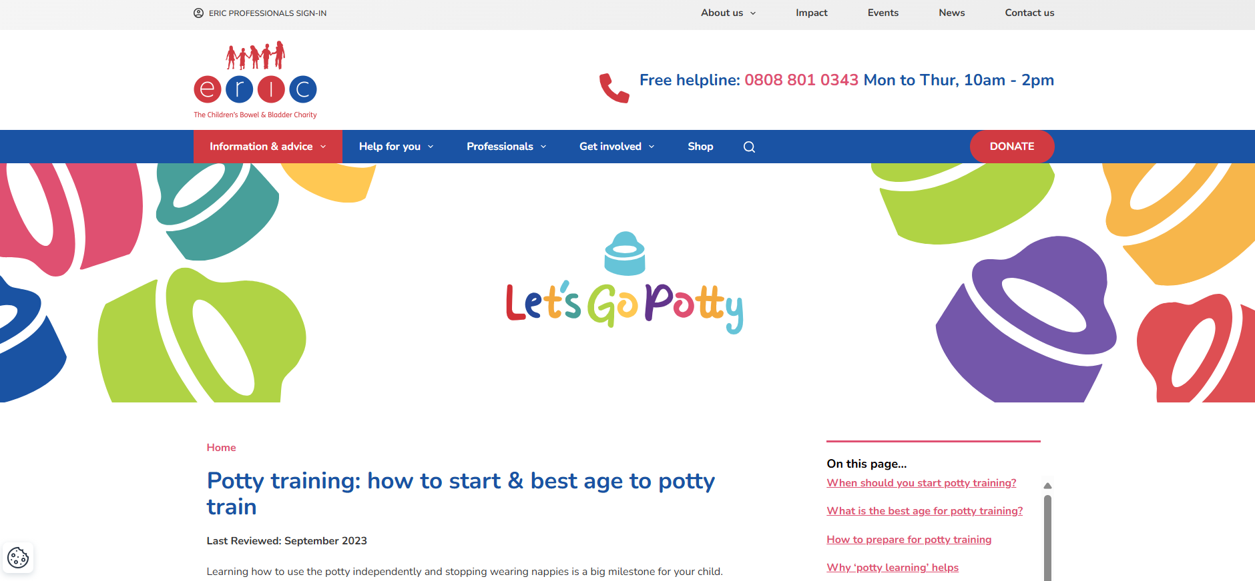
Skills to practice before starting Reception…

Slide 11
Induction Process
Stay and Play
Tuesday 30th June 9.30-11.00 Group A (surnames A-P)
Wednesday 1st July 9.30-11.00 Group B (surnames Q-Z)

Slide 12
Induction Process
During the first week, children will have a staggered start to school.
Monday 24th August 8.50 - 12.00 Group A (surnames A-P)
Tuesday 25th August 8.50 - 12.00 Group B (surnames Q-Z)
Wednesday 26th August 8.50-12.00 Group A (surnames A-P)
Thursday 27th August 8.50 - 12.00 Group B (surnames Q-Z)
Friday 28th August 8.50 - 12.00 Group A (surnames A-P)
Tuesday 1st September 8.50 - 1.00 Group B (surnames Q-Z)
Wednesday 2nd September 8.50-1.00 Group A (surnames A-P)
Thursday 3rd September onwards - all children in full time 8.50 - 3.30
Afternoon parent liaison meetings available

Slide 13
School Uniform
Please ensure all uniform is labelled with your child’s name including PE kit.
  Grey or black trousers or shorts
  Grey tunic or skirt
  Red sweatshirt with school logo or red jumper/cardigan
  White or red shirt, blouse or polo shirt
  Grey, red, black or white socks or tights
  Dark coloured footwear with velcro fastenings (NO LACES)
  A spare set of clothes including pants, socks, tights, etc in a labelled carrier bag
  A pair of wellies
  A waterproof coat
More information about ordering uniform and school bookbags can be found from the school office.

Slide 14
PE Kit
This stays in school and goes home every half-term.
A drawstring bag is needed - NO BACKPACKS DUE TO LIMITED SPACE
  White round neck plain t-shirt
  Black shorts (not cycling shorts)
  Indoor plimsoles
  No jewellery
NO BRANDED CLOTHES FOR PE KIT OR SCHOOL UNFORM PLEASE.

Slide 15
Lunches
Hot dinners
  No charge for Reception, Year 1 and Year 2
  Order from Relish website (links will be provided from the school office once admissions forms are completed for your child)
Packed lunches
  Named lunch box
  No sweets, fizzy drinks, nuts or glass bottles
We are a nut free school and provide milk for free until your child turns 5. We also provide fruit and vegetables throughout the year for the children.

Slide 16
Medical Matters
Please read the paperwork provided in your packs about sickness, health and early childhood illnesses.
Sickness and diarrhoea - 48 hours absence or until symptoms have cleared for a full 24 hours.
Any absence requires an email or telephone call to the office explaining why.
Any medicines required to be administered by school staff will need a form to be filled at the office by parents/carers.
Asthmer inhalers - need to be in school and labelled.
Please fill in the medical form carefully and return ASAP even if your child has no medical needs.

Slide 17
Practical details
We finish at 3.30 - please try to be on time as this may upset your child.
Children will be released out of the Reception Class red doors when we see you or the person collecting your child (PASSWORDS).
If someone different is collecting your child, please let a member of the EYFS know beforehand or the school office.

Slide 18
Practical details
We operate an open-door policy. We are always happy to help any parent/carer requiring information or advice.
Children will be very tired initially - school is hard work when you are 4!!

Slide 19
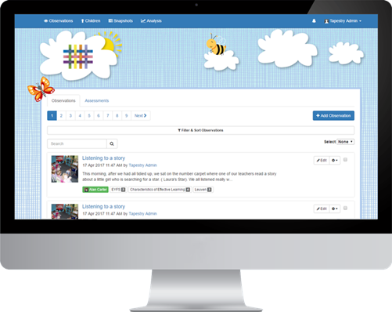
Tapestry
  We do not use it all of the time
Used in EYFS
  Upload pictures and leave comments
  There is no expectation for us to check it regularly and make comments

Slide 20
Any Questions?
If you have any questions, please ring the school office or email us.
office@stlukes.risemat.co.uk
Thank you for attending. We hope that you and your child/children will enjoy being a part of the St. Luke’s family over the coming years.

